Slide 1


Microsoft Copilot for Azure
A look into the preview of the public preview of Microsoft Copilot for Azure

Slide 2




So, who am I?
My name is Luke Murray
He/Him
Senior Consultant in Hamilton, New Zealand.
Feel free to reach out on Social Media, if you need any help: https://linktr.ee/lukemurray
Introduction
Azure Cloud
Commanders

Slide 3
Copilot for Azure is offered at no additional cost during the preview.
Signup:
https://aka.ms/MSCopilotforAzurePreviewRequest
Notes:
Microsoft Copilot for Azure (preview) requires registration and is currently only available to approved enterprise customers and partners. Customers who wish to use Microsoft Copilot for Azure (preview) are required to submit a registration form.
Access to Microsoft Copilot for Azure (preview) is subject to Microsoft's sole discretion based on eligibility criteria and a vetting process, and customers must acknowledge that they have read and understand the Azure terms of service for Microsoft Copilot for Azure (preview).

Slide 4

KEEP
CALM
AND
COPILOT IT IN AZURE
What is Azure Copilot?

Slide 5
“Simplify operations and management from cloud to edge with an AI companion”
Mission statement
Notes:
Copilot for Azure is an AI companion that simplifies how you design, operate, optimize, and troubleshoot apps and infrastructure from cloud to edge.
With Copilot, gain new insights, discover more benefits of the cloud, and orchestrate data across both the cloud and the edge. Copilot AI assistance utilizes language models, the Azure control plane, and insights about your Azure and Arc–enabled assets.
All of this is carried out within the framework of Azure's steadfast commitment to safeguarding your data security and privacy.
Microsoft Copilot for Azure is designed to generate the best possible responses with the context it has access to.
However, like any AI system, Microsoft Copilot for Azure's responses will not always be perfect. All of Microsoft Copilot for Azure's responses should be carefully tested, reviewed, and vetted before making changes to your Azure environment.

Slide 6
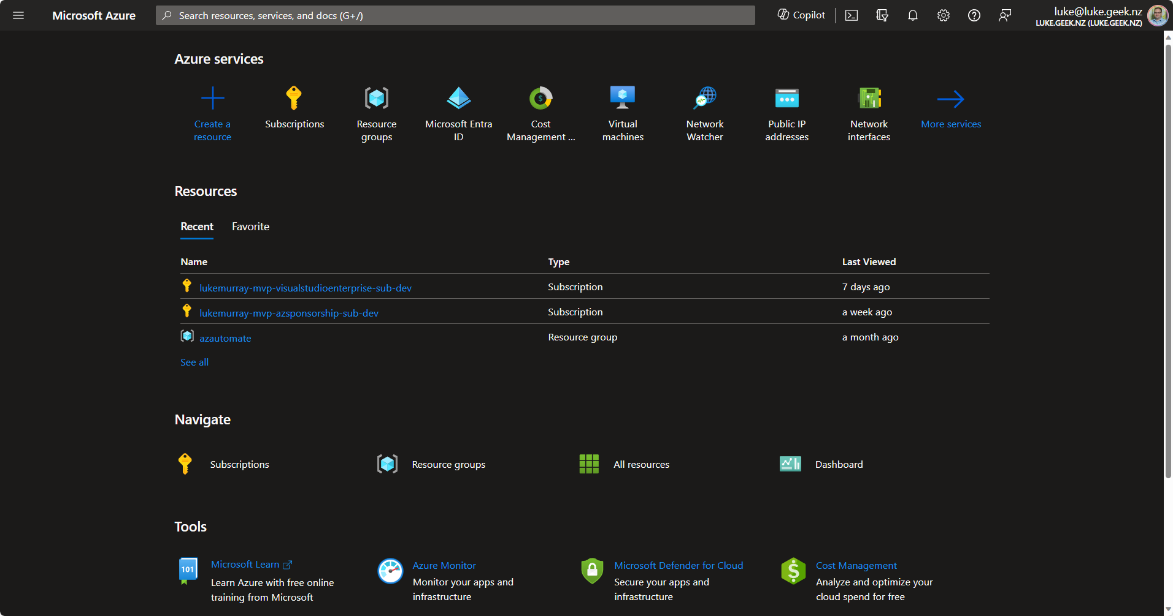
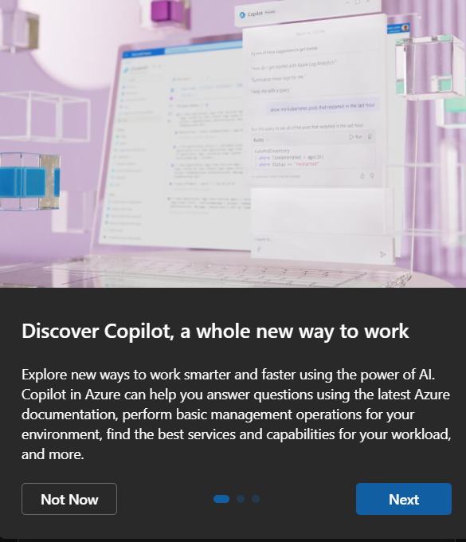
Notes:
Enabled at a tenancy level, for all users and subscriptions

Slide 7
It is in Preview!
Notes:
Disclaimer: Public Preview as of Jan 2024, responses and capabilities can change daily. What you see today, may not necessary match what you get when it goes GA.
Pricing hasn’t been announced, this functionality is free during Public preview., whether it remains free is still to be confirmed

Slide 8
Ten questions per convo (5 convo per day per user)
Some responses that use lists, limited to top 5
Microsoft Copilot for Azure
Some tasks, resource name won’t work, Resource ID required
Limitations
Available in English only
Cost management scope at Subscription
Limited number of skills

Slide 9
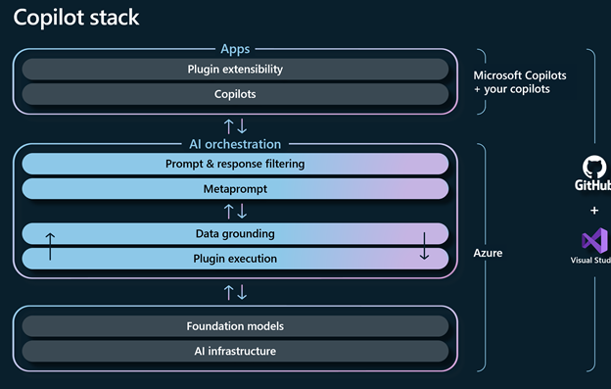
Azure Copilot portal
Copilot Stack
Prompt and context
RAG
(Retrieval augmented generation)
Meta prompt and response
Notes:
Portal – Azure Bot framework
RAG (Microsoft Learn Documentation, Azure Resource Graph, Cost Management, Skills, Guardrails (i.e. Azure Policy, RBAC, Budgets)
Microsoft Copilot for Azure only has access to resources that you have access to and can only perform actions that you have the permissions to perform, after your confirmation. Microsoft Copilot for Azure will respect all existing access management and protections such as Azure Role-Based Action Control, Privileged Identity Management, Azure Policy, and resource locks.
Ground together
(GPT 4)

Slide 10



Design
Configure and create the right services
Operate
Answer questions, author complex commands, and manage resources
Troubleshoot
Orchestrate across Azure services for insights to summarize issues, identity cussed and suggest solutions
Optimize
Improve costs, scalability, and reliability through recommendations for your environment
Teams
Business
Microsoft Copilot for Azure
Platforms

Slide 11
KEEP
CALM
AND
COPILOT IT IN AZURE
Design
Notes:
Be curious:
General: I want to setup a new web application for internet shopping, what infrastructure should I use?
Intermediate: When setting up a new web service, that allows people to purchase my products using Azure services, what infrastructure should I use?
Intermediate: List all suggested Azure services for my internet shopping service and how they could connect together, including considerations?
Intermediate: Create these services
# Operation not currently supported.
Advanced: Are there any services I am missing? Also list all the suggested services in a table, including a column on what each service could be used for when looking at my internet shopping application
Advanced: What is the recommended requirements that I need to gather, to create my scalable and secure internet shopping application? List requirements, as a list
Advanced: Give me examples of security requirement questions?’

Slide 12
KEEP
CALM
AND
COPILOT IT IN AZURE
Operate
Notes:
General: List all resources and their regions
5 – remember list limitation
Create a table of all resources and their region?
Same issue.
Give me a list of the top resource types?
List all virtual machines and their power state?
Shutdown all virtual machines currently running
Start all virtual machines currently stopped
Can you help me reset the password of VM1?

Slide 13
KEEP
CALM
AND
COPILOT IT IN AZURE
Optimize
Notes:
List all recommendations from Azure advisor?
Show me the highest resource cost for the past 12 months?
# Select scope trey platform – unable to support management group scopes.
How can I optimize my environment?
create a naming convention for SQL databases
How can I protect my storage accounts
Show me all resources that are noncompliant

Slide 14
KEEP
CALM
AND
COPILOT IT IN AZURE
Troubleshoot
Notes:
How can I troubleshoot not being able to rdp to VM-1
Check 3389 is open on VM-1
What are the security implications of opening port 3389?
Create PowerShell script to test 3389 is opened on VM-1
adjust the script to use its public IP instead
Take me to VM-1
What is the public IP of VM-1
What is this resource?
What are the open alerts?
Am I impacted by any service health events?

Slide 15
KEEP
CALM
AND
COPILOT IT IN AZURE
Other
Notes:
Change theme to light or dark
Infrastructure as code – reader.

Slide 16
Get Resource Info
Build Virtual Machines
Deploy Infrastructure
Get monitoring info
Optimize your code
Azure Stack HCI
Secure and protect storage accounts
Troubleshoot WebApps
Author API Management Policies
Generate Kubernetes YAML files
Understand service health
Analyze costs
Tasks
Skills
Notes:
Enhanced scenarios or skills

Slide 17
Conclusion
Notes:
As a beginner user to Azure, I feel that Microsoft Copilot for Azure, can help point you in the right directions, and to the right information.
Context is key – the service, takes context on what resource you are at in the Azure Portal, so the more context it has on the resource the better outputs you will get.
As with all generative AI services, clear prompts are key, and don’t trust the outputs, not all Graph queries are right.
In terms of more intermediate and advanced services, it won’t replace full on azure management capabilities and troubleshooting yet, remember this is a copilot, an assistant.
The more feedback can be offered, as part of its use – the better it would be, and more skills and tasks it will be able to complete.

Slide 18

THANK YOU!

